Slide 1







Emerging Programming Skills Analysis for Future Skill Requirements
Lucas Silva
02/06/2023

Slide 2



OUTLINE
Executive Summary
Introduction
Methodology
Results
Visualization – Charts
Dashboard
Discussion
Findings & Implications
Conclusion
Appendix

Slide 3

EXECUTIVE SUMMARY
This project analyzed emerging programming skills to identify future skill requirements within the IT industry. By collecting data from various sources and applying statistical techniques, we uncovered the top programming languages, in-demand database skills, and popular IDEs. The insights gained empower informed decision-making and enable organizations to stay competitive in the ever-changing IT landscape.

Slide 4

INTRODUCTION
This project aims to analyze the top programming skills in demand for future skill requirements within a global IT and business consulting services firm. As a Data Analyst, I collected data from various sources, including job postings, training portals, and surveys, to identify trends and insights. By leveraging web scraping, APIs, and data wrangling techniques, I gathered and prepared the data for analysis. Statistical techniques were applied to uncover the top programming languages, database skills, and popular IDEs. The findings were visualized using IBM Cognos Analytics to create an informative dashboard.

Slide 5

METHODOLOGY
Data Collection
API used: http://api.open-notify.org/astros.json
For Webscraping: https://cf-courses-data.s3.us.cloud-object-storage.appdomain.cloud/IBM-DA0321EN-SkillsNetwork/labs/datasets/Programming_Languages.html
Data Wrangling
In this process we gathered all the data in order to prepare it, we find null values, duplicated values, normalized some data, this processes were mainly done by pandas dataframe methods to be more practical.
Data Analysis
For data analysis step, we focused on visualizing the data through different charts and with different variables, this step allowed me to check for relationships in the data, along with the visualizations I run some statistical analyses too to see for discrepancies in the data and even to spot outliers.
IBM Cognos Analytics
In this final step many different charts/graphs were used to highlight the insights of the data, and were mainly in this step that was possible to communicate in a way the everyone could understand and set foundations about the data.

Slide 6
RESULTS
After the final step mentioned in the previous slide we can list some of the results of the project:
We could spot the most used programming languages, databases, platforms and webframes nowadays and the most desired ones for the next year according to the respondents of the study.
Besides of the technical review we had also some a demographics one, so to speak, where we understood how the respondents were grouped according to their country, age, gender, and even education level.

Slide 7
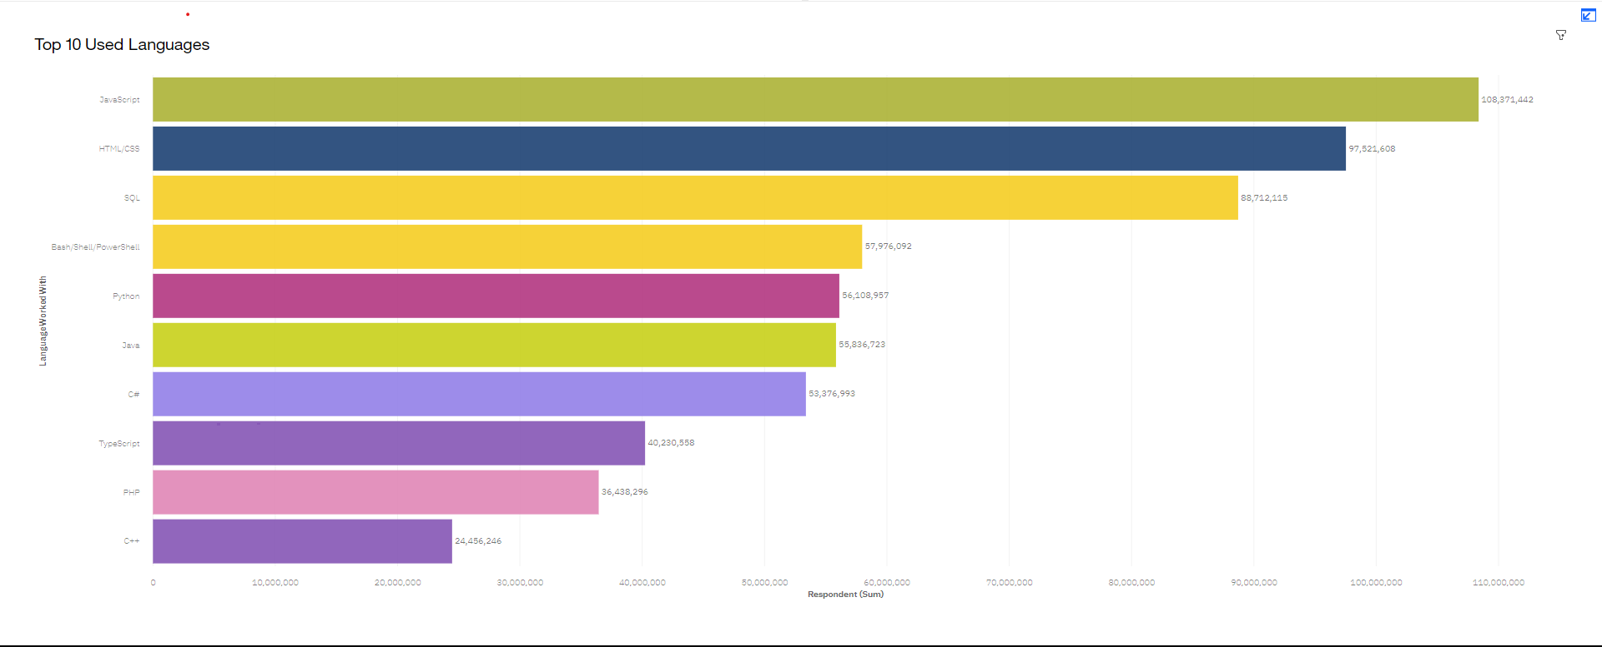
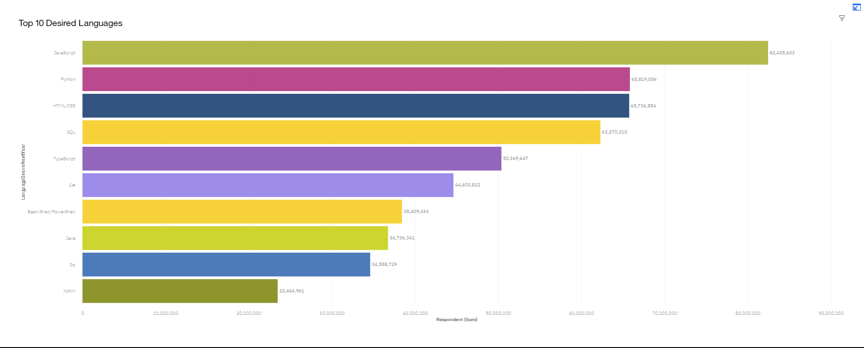
PROGRAMMING LANGUAGE TRENDS
Current Year
Next Year

Slide 8
PROGRAMMING LANGUAGE TRENDS - FINDINGS & IMPLICATIONS
Findings
Python will have significantly more users
Javascript stills leading
Languages like “Go” and “kotlin” appeared in trends
Implications
Individuals who would like to embrace the field should really consider learning python due to its rapidly growth
Still having Javasctipt assigned to the curriculum still a good idea
Emerging languages must be taken into account too, to be updated

Slide 9
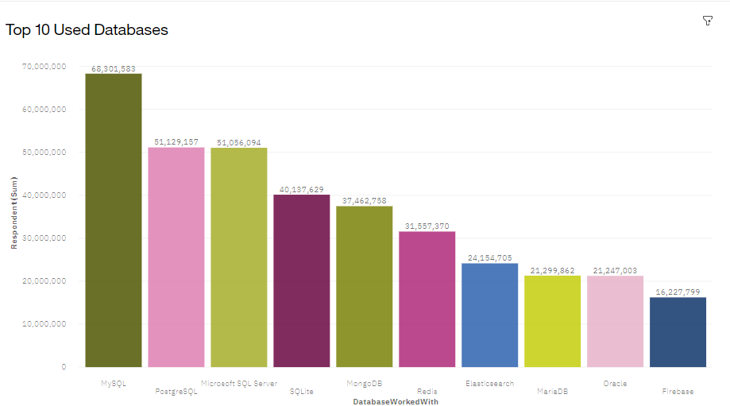
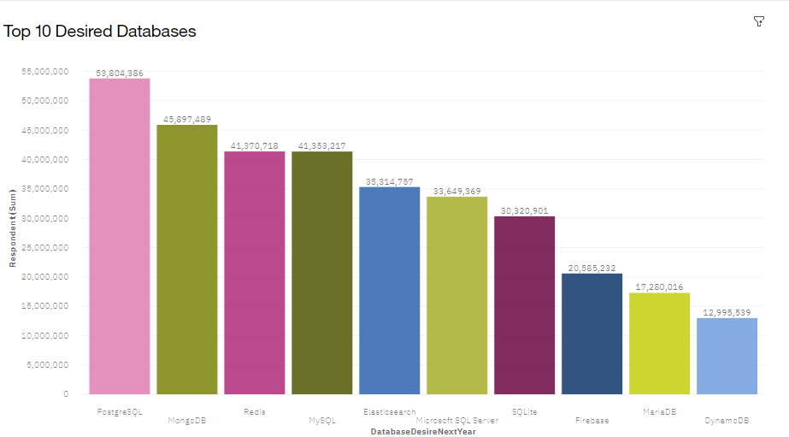
DATABASE TRENDS
Current Year
Next Year

Slide 10
DATABASE TRENDS - FINDINGS & IMPLICATIONS
Findings
PostgresSQL took the first place
MongoDB’s usage will be increased greatly
MySQL has been not used compared to nowadays
Implications
It’s recommended to learn PostgresSQL for future learners
As PostgresSQL will be mora valuable
Otherwise, MySQL lost value, so to speak

Slide 11

DASHBOARD
https://eu-de.dataplatform.cloud.ibm.com/dashboards/bf6736d0-9ac0-4eec-9a34-3625267acd5b/view/441ad529129b0bdc64dcbde407cd2e0279667158e3bbd55082877b490f612097f03b15c3c87e4c088b150532a1bf44089a

Slide 12
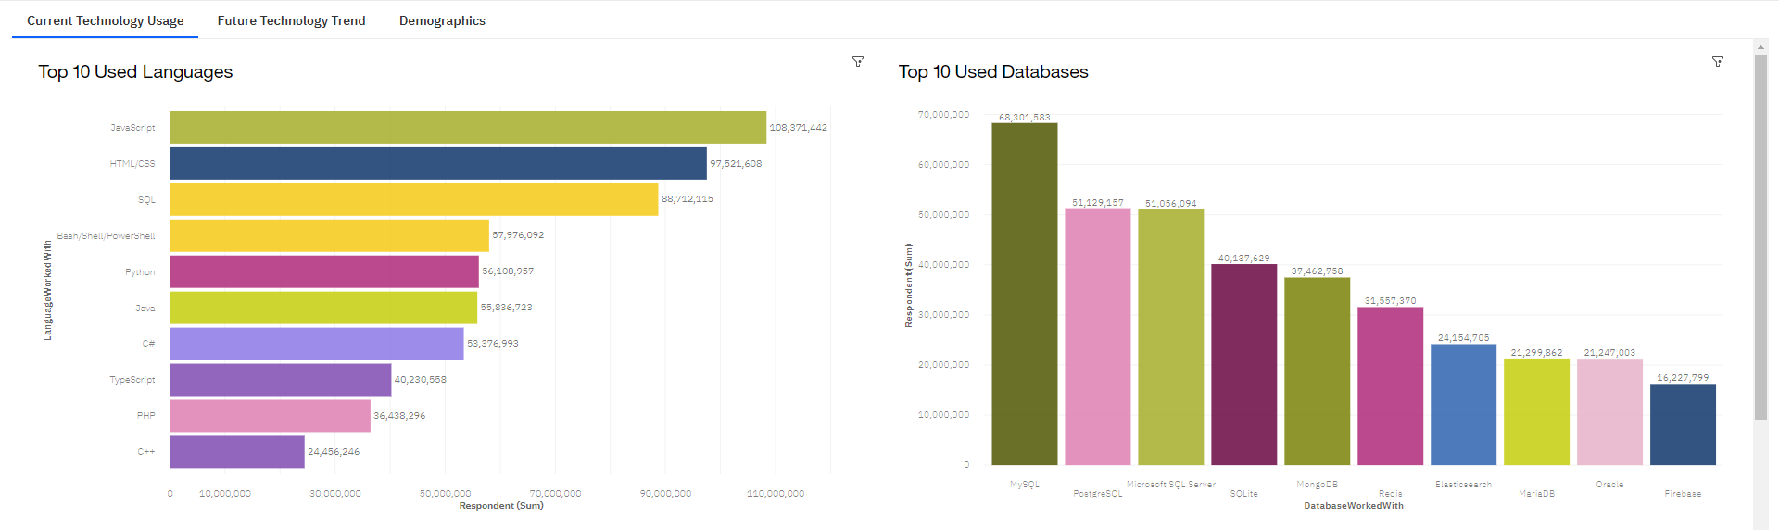
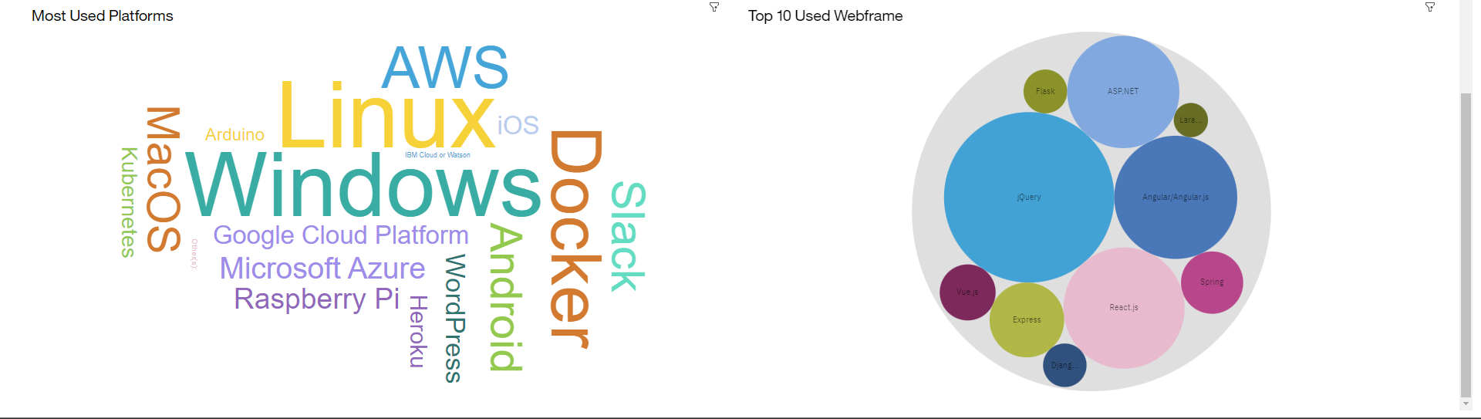
DASHBOARD TAB 1

Slide 13
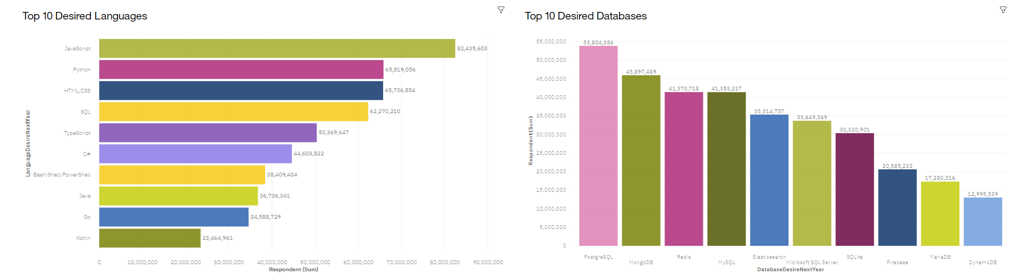
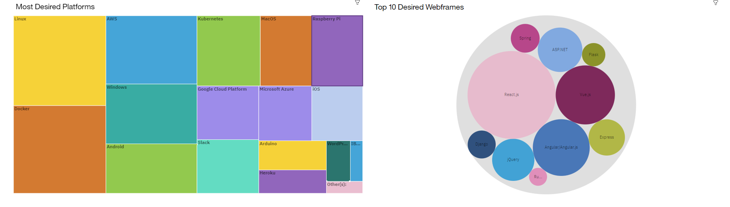
DASHBOARD TAB 2

Slide 14
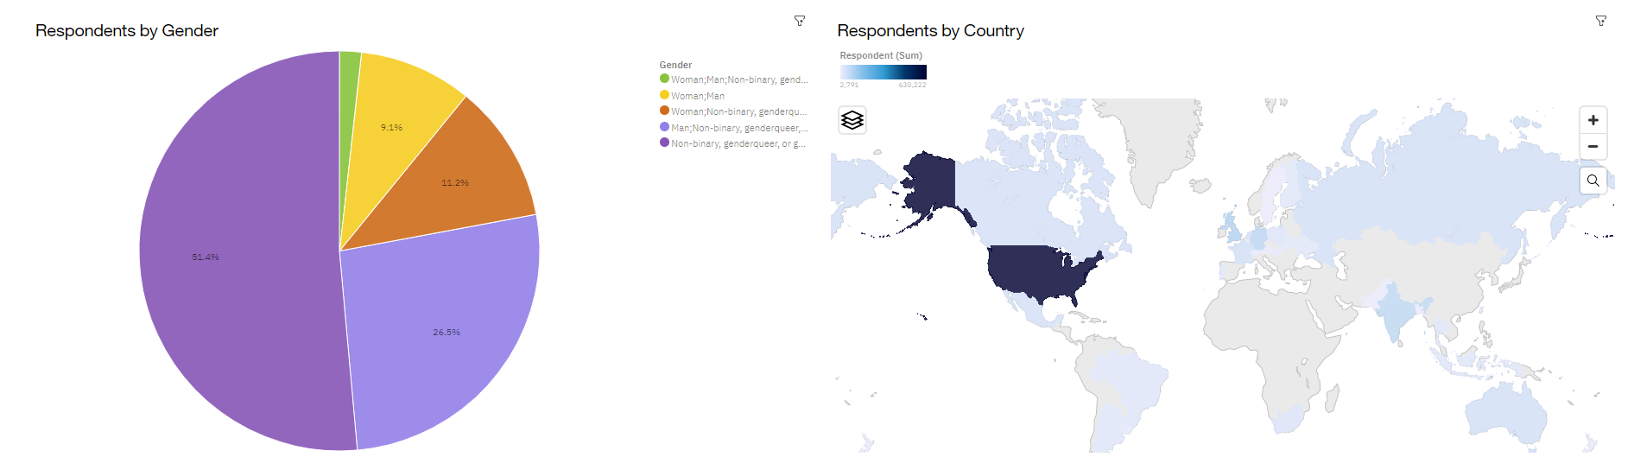
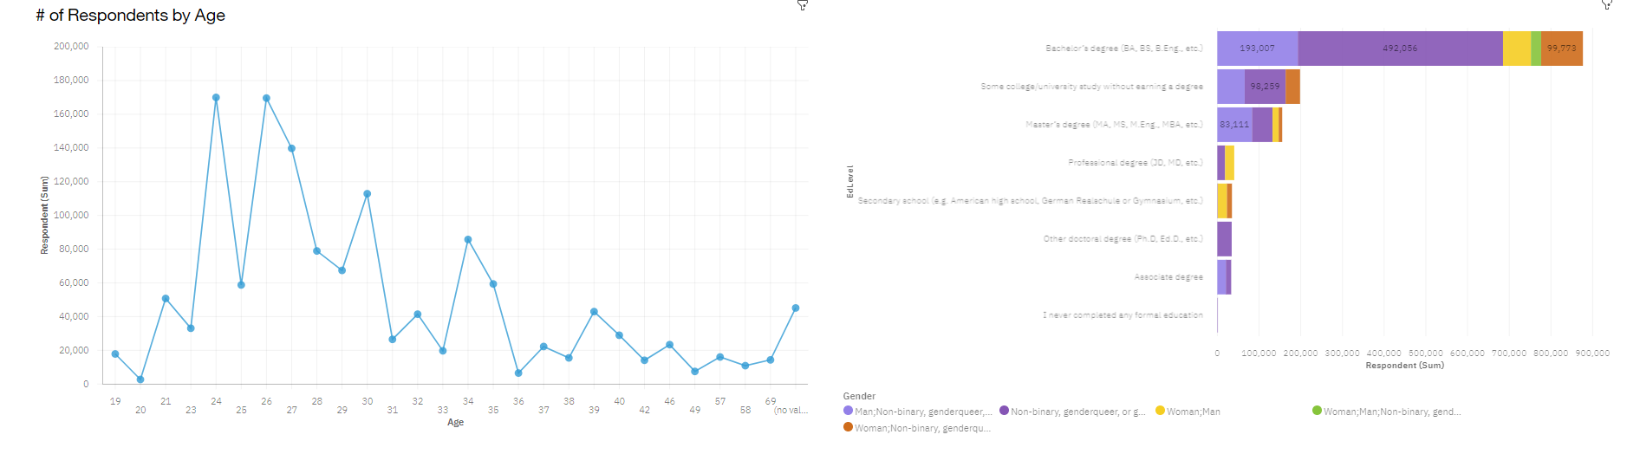
DASHBOARD TAB 3

Slide 15
DISCUSSION
Python's projected growth indicates increasing demand; prioritize learning it for better career prospects.
JavaScript's continued dominance reinforces its importance; essential for web development and offers abundant job opportunities.
Emerging languages like Go and Kotlin show potential; consider exploring their unique features for specific domains.

Slide 16

CONCLUSION
Through comprehensive data analysis, we have identified the top programming languages, in-demand database skills, and popular IDEs. These insights enable informed decision-making for future skill requirements. Embrace these trends to stay ahead in the rapidly evolving IT landscape.

Slide 17
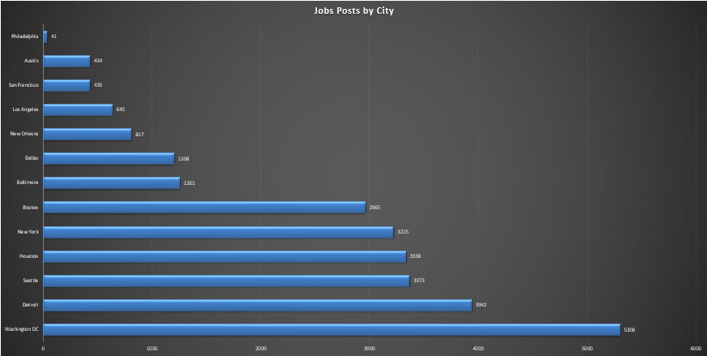
JOB POSTINGS

Slide 18
POPULAR LANGUAGES
In Module 1 you have collected the job postings data using web scraping in a file named “popular-languages.csv”. Present that data using a bar chart here. Order the bar chart in the descending order of salary.

